Slide 1
Classification and Prediction

Slide 2
Contents
What is classification? What is prediction?
Issues regarding classification and prediction
Classification by decision tree induction
Bayesian Classification
Classification by backpropagation
Classification based on concepts from association rule mining
Other Classification Methods
Prediction
Classification accuracy
Summary

Slide 3
What is classification? What is prediction?

Slide 4
Classification vs. Prediction
Classification & Prediction
  Two forms of data Analysis
  Used to extract models describing important data classes or to predict future data trends
  Help to provide better understanding of data

Slide 5
Classification vs. Prediction
Classification:
  predicts categorical class labels – discrete & unordered values
  classifies data (constructs a model) based on the training set and uses it in classifying new data
Prediction:
  models continuous-valued functions, i.e., predicts unknown or missing values
  Regression Analysis is used

Slide 6
Classification vs. Prediction
Typical Applications
  credit approval
  target marketing
  medical diagnosis
  treatment effectiveness analysis

Slide 7
Classification—A Two-Step Process
Step 1:- Model construction: describing a set of predetermined set of data classes or concepts.
This is the learning step or training phase.
  Learning of a mapping or function y= f(x)
  - it can predict the associated class label ‘y ‘ of a
  given tuple ‘x’.
  - this separates the data classes
  - Provides compressed representation of data

Slide 8
Classification—A Two-Step Process
Step 1 continues….
  Each tuple/sample is assumed to belong to a predefined class, as determined by the class label attribute
  The set of tuples used for model construction: training set
  The model is represented as classification rules, decision trees, or mathematical formulae
  In the example given , mapping is represented in a classification rule “safety/risky”

Slide 9
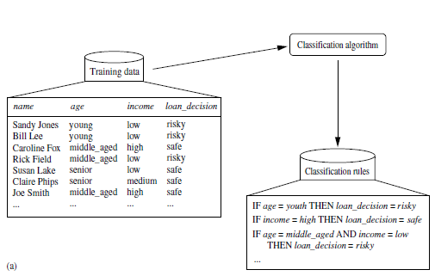
Classification—A Two-Step Process
Step 1 example

Slide 10
Classification—A Two-Step Process
Step2:- Model usage: for classifying future or unknown objects
  Estimate accuracy of the model
    The known label of test sample is compared with the classified result from the model
    Accuracy rate is the percentage of test set samples that are correctly classified by the model.
    When training set is used, classifier tends to over fit the data
    Test set is independent of training set, to avoid such over-fitting

Slide 11
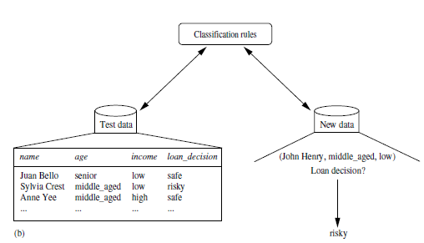
Classification—A Two-Step Process
Step 2 example
Here categorical attribute is “Loan Decision”

Slide 12
Supervised vs. Unsupervised Learning
Supervised learning (classification)
  Supervision: The class label of each training tuple is provided ,this step is also known as supervised learning
  Unsupervised learning (clustering)
  The class labels of training data is unknown and the number or set of classes to be learned may not be known in advance.

Slide 13
Diff. of Numeric prediction from classification
Data prediction also a two step process
  Here values being predicted is continuous valued (orderd)
  The attribute referred as predicated attribute
  Eg. The problem of predicting the “amount” that would be safe to loan an applicant
  Here the predicted attribute is “ Loan Amount”
  It also uses a mapping or function y=F(x)

Slide 14
Issues regarding classification and prediction

Slide 15
(1) Preparation the data for classification & prediction
Need to use following Preprocessing Steps to improve accuracy, efficiency and scalability of process.
Data cleaning
  Preprocess data in order to reduce noise and handle missing values
Relevance analysis
  Remove the irrelevant or redundant attributes (using correlation analysis)
  Attribute subset selection can be used in the case to find a reduced set of attributes
Data transformation & reduction
  Generalize and/or normalize data

Slide 16
(ii) Comparison of Classification & Prediction
Methods
Classification & prediction methods can be evaluated by following criteria
Accuracy
The accuracy of a classifier refers to the ability of a given classifier to correctly predict the class label of new or previously unseen data.
The accuracy of a predictor refers to how well a given predictor can guess the value of the predicted attribute for new or previously unseen data..
Speed
  time to construct the model
  time to use the model

Slide 17
(ii) Comparison of Classification & Prediction
Methods
Robustness
  Make correct predictions -handling noise and missing values
Scalability
  efficiency in handling large amounts of data
Interpretability:
  understanding and insight provided by the model

Slide 18
Classification by decision tree induction

Slide 19
Classification by Decision Tree Induction
Decision tree induction involves the learning of decision trees from class labeled training tuples.
Decision tree
  A flow-chart-like tree structure
  Internal node denotes a test on an attribute - rectangle
  Branch represents an outcome of the test
  Leaf nodes represent class labels or class distribution – ovals
  Topmost node represents root of the tree
Decision tree algorithm results either
  Binary tree or
  Non binary tree

Slide 20
Adv. / Features make decision tree (DT) popular
Construction of decision tree doesn’t require any domain knowledge
This property make it suitable for exploratory knowledge discovery
DT can handle high dimensional data
Tree is easy to assimilate by humans
The learning & classification steps of tree induction are simple and faster
DT classifiers have good accuracy
Application areas are medicine, manufacturing & production, Financial analysis, Astronomy & molecular Biology

Slide 21
Basic Steps
Decision tree generation consists of two phases
  Learning Decision Tree (DT induction)
    Done by using basic DT algorithm
    Attribute selection measures are used to select attribute that best partitions the tuples into distinct classes.
  Tree pruning
    Identify and remove branches that reflect noise or outliers
Use of decision tree: Classifying an unknown sample
  Test the attribute values of the sample against the decision tree

Slide 22
Step1 – Decision Tree Induction
Popular DT algorithms are
  ID3 – Iterative Dichotomizer
  C4.5 – Successor of ID3
  CART – Classification and Regression Trees
Strategy used
  Greedy approach
  Uses top down approach in recursive DandC manner

Slide 23
Output: A Decision Tree for “buys_computer”
age?
<=30
overcast
>40
30..40
student?
yes
credit rating?
no
yes
excellent
fair
no
yes
no
yes

Slide 24
Method for Decision Tree Induction
Basic algorithm (a greedy algorithm)
  Tree is constructed in a top-down recursive divide-and-conquer manner
  At start, all the training examples are at the root
  Attributes are categorical (if continuous-valued, they are discretized in advance)
  Examples are partitioned recursively based on selected attributes
  Test attributes are selected on the basis of a heuristic or statistical measure (Ex: information gain)
Conditions for stopping partitioning
  All samples for a given node belong to the same class
  There are no remaining attributes for further partitioning – majority voting is employed for classifying the leaf
  There are no samples left
Notes:
Refer Text Page:292
Discrete-valued/continuous-valued/discrete-valued and a binary tree

Slide 25
Algorithm for Decision Tree Induction
Algorithm: Generate a decision tree from the training tuples of data partition D.
Input:
Data partition, D, which is a set of training tuples and their
associated class labels;
attribute list, the set of candidate attributes;
Attribute selection method, a procedure to determine the splitting criterion that “best” partitions the data tuples into individual classes. This criterion consists of a splitting attribute
and, possibly, either a split point or splitting subset.
Output: A decision tree.
Notes:
Refer Text Page:292
Discrete-valued/continuous-valued/discrete-valued and a binary tree

Slide 26
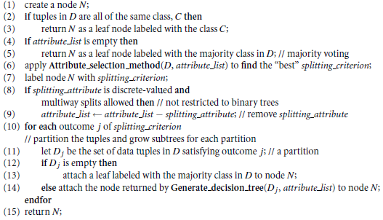
Algorithm for Decision Tree Induction…
Method:
Notes:
Refer Text Page:292
Discrete-valued/continuous-valued/discrete-valued and a binary tree

Slide 27
Attribute Selection Measures
An attribute selection measure is a heuristic for selecting the splitting criterion that “best” separates a given data partition.Three commonly used attributes are:
Information gain (ID3/C4.5)
  All attributes are assumed to be categorical
  Can be modified for continuous-valued attributes
Gini index (IBM IntelligentMiner)
  All attributes are assumed continuous-valued
  Assume there exist several possible split values for each attribute
  May need other tools, such as clustering, to get the possible split values
  Can be modified for categorical attributes
Notes:
C4.5 - a successor of ID3

Slide 28



Information Gain (ID3/C4.5)
Select the attribute with the highest information gain
The expected information needed to classify a tuple in D is given by
The expected information needed to classify a tuple in D in a given attribute ‘A’ is given by
Information Gain on attribute ‘A” is

Slide 29


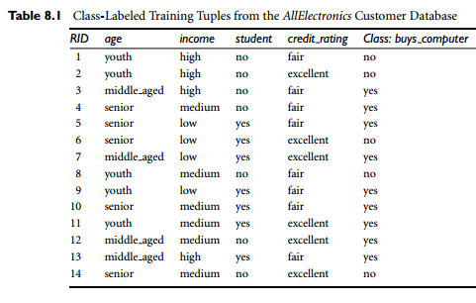
Example

Slide 30




Attribute Selection by Information Gain Computation
To ﬁnd the splitting criterion for these tuples, we must
compute the information gain of each attribute.
Hence, the gain in information from such a partitioning would be

Slide 31
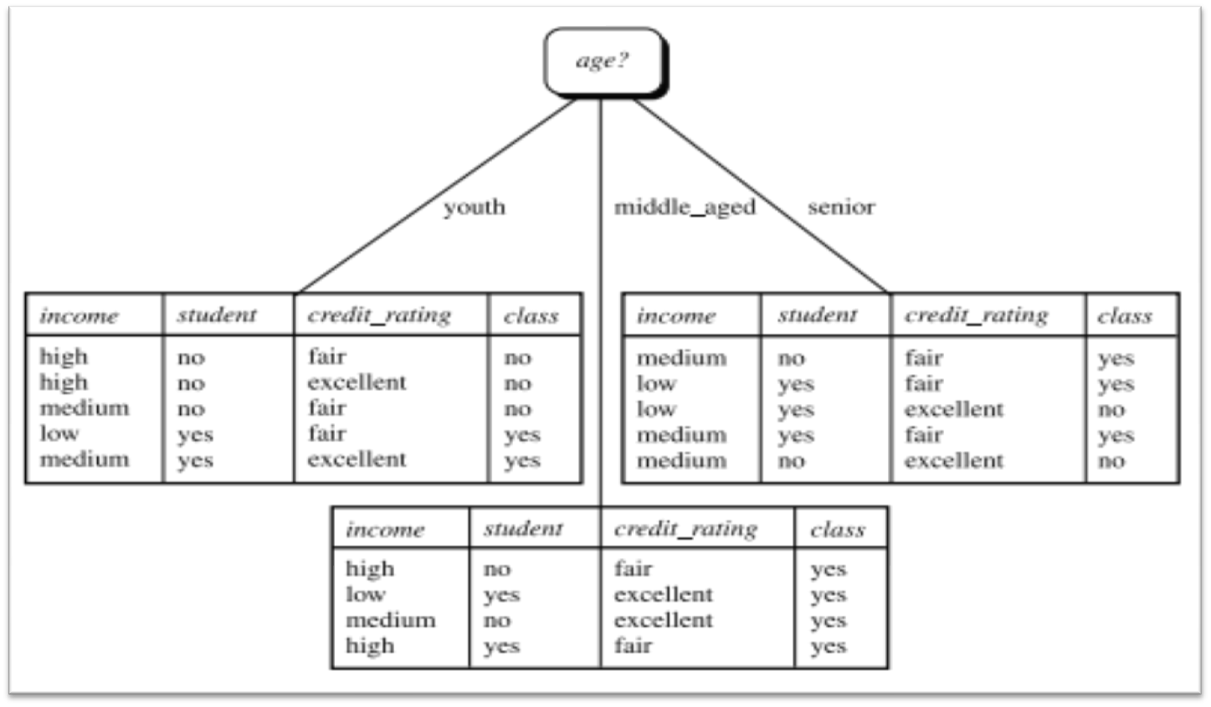
Attribute Selection by Information Gain Computation

Slide 32



Gini Index
Gini Ratio
Notes:
Used in CART (classification & regression trees)

Slide 33
Avoid Overfitting in Classification (Tree Pruning)
The generated tree may overfit the training data
  Too many branches, some may reflect anomalies due to noise or outliers
  Result is in poor accuracy for unseen samples
Two approaches to avoid overfitting
  Prepruning: Halt tree construction early—do not split a node if this would result in the goodness measure falling below a threshold
    Difficult to choose an appropriate threshold
  Postpruning: Remove branches from a “fully grown” tree—get a sequence of progressively pruned trees
    Use a set of data different from the training data to decide which is the “best pruned tree”

Slide 34
Approaches to Determine the Final Tree Size
Use all the data for training
  but apply a statistical test (Ex: chi-square) to estimate whether expanding or pruning a node may improve the entire distribution
Use minimum description length (MDL) principle:
  halting growth of the tree when the encoding is minimized

Slide 35
Why decision tree induction in data mining?
  relatively faster learning speed (than other classification methods)
  convertible to simple and easy to understand classification rules
  can use SQL queries for accessing databases
  comparable classification accuracy with other methods

Slide 36
Bayesian Classification

Slide 37
Bayesian Classification
Bayesian Classifiers are statistical classifiers
They can predict class membership probabilities, such as the probability that a given tuple belongs to a particular class
Bayesian classification is based on Bayes’ theorem
Bayesian classifiers have high accuracy and speed
Simple Bayesian classifier – naïve Bayesian classifier - is comparable in performance with decision tree

Slide 38

Bayes’ Theorem
Let X be a data tuple, considered as “evidence”
Let H be some hypothesis, such as that X belongs to a specified class C
For classification problems, we want to determine P(H\X) - the probability that tuple X belongs to class C, given that the attribute description of X..

Slide 39
Bayes’ Theorem …..
Suppose the data tuples is confined to customers by the attributes age and income, and X is a 35-year-old customer with an income of Rs.40,000. Suppose that H is the hypothesis that the customer will buy a computer.
Then P(H\X) is the posterior probability , reflects the probability that customer X will buy a computer
P(H) is the prior probability, or a priori probability, of H
P(X\H) is the posterior probability of X conditioned on H. ie, it is the probability that a customer, X, is 35 years old and earns Rs.40,000, given that we know the customer will buy a computer

Slide 40
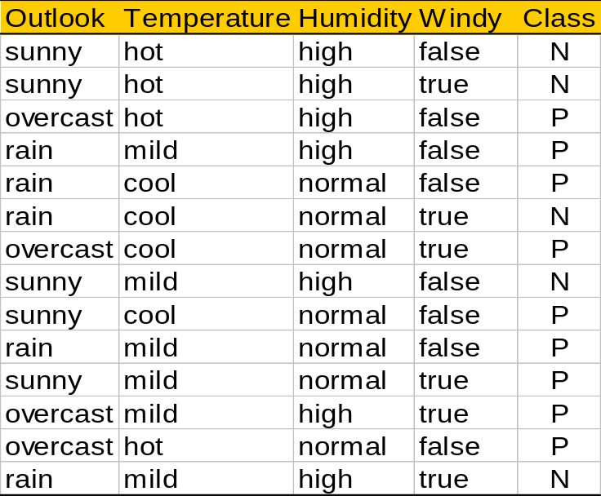
Play-tennis example: estimating P(x_{i}|C)
outlook
P(sunny|p) = 2/9 | P(sunny|n) = 3/5
P(overcast|p) = 4/9 | P(overcast|n) = 0
P(rain|p) = 3/9 | P(rain|n) = 2/5
temperature
P(hot|p) = 2/9 | P(hot|n) = 2/5
P(mild|p) = 4/9 | P(mild|n) = 2/5
P(cool|p) = 3/9 | P(cool|n) = 1/5
humidity
P(high|p) = 3/9 | P(high|n) = 4/5
P(normal|p) = 6/9 | P(normal|n) = 2/5
windy
P(true|p) = 3/9 | P(true|n) = 3/5
P(false|p) = 6/9 | P(false|n) = 2/5
P(p) = 9/14
P(n) = 5/14

Slide 41
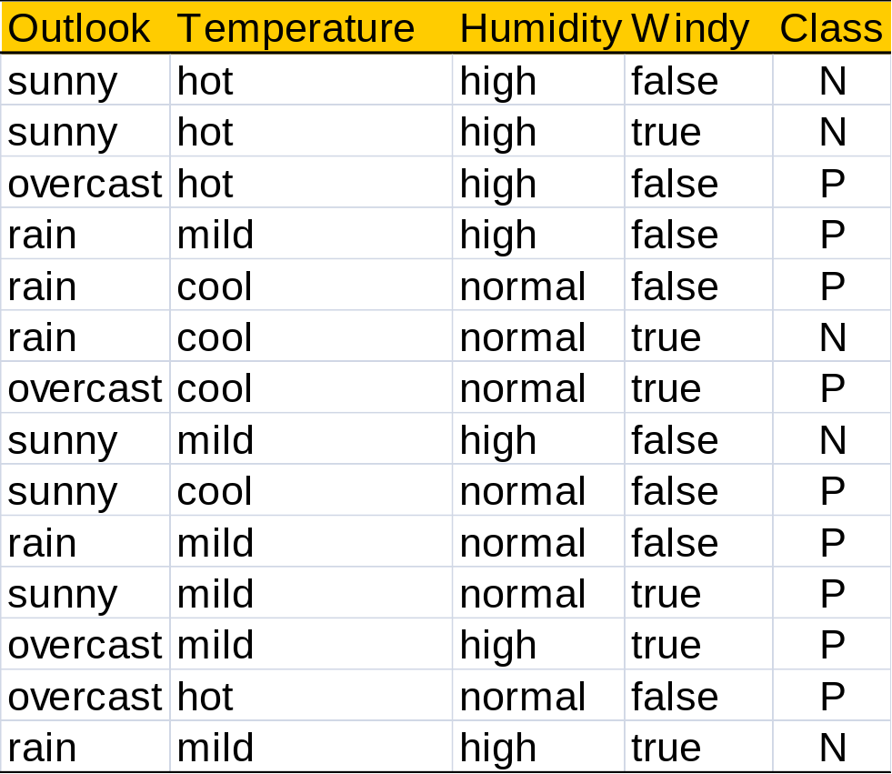

Slide 42
Naïve Bayesian Classification
The naïve Bayesian classifier, or simple Bayesian classifier, works as follows:
(1) Let D be a training set of tuples and their associated class labels. As usual, each tuple X = (x1, x2, …, xn)
(2) Suppose that there are m classes, C1, C2,.., Cm. Given a tuple, X, the classifier will predict that X belongs to the class having the highest posterior probability, conditioned on X. That is, the naïve Bayesian classifier predicts that tuple X belongs to the class Ci if and only if

Slide 43

Naïve Bayesian Classification…
Thus we maximize P(Ci\X). The class Ci for which P(CijX) is maximized is called the maximum posteriori hypothesis. By Bayes’ theorem
(3) As P(X) is constant for all classes, only P(XjCi)P(Ci) need be maximized. If the class prior probabilities are not known, then the classes are equally likely, that is, P(C1) = P(C2) = = P(Cm), and therefore maximize P(XjCi). Otherwise, we maximize P(XjCi)P(Ci).

Slide 44

Naïve Bayesian Classification…
(4) For the data sets with many attributes, it is expensive to compute P(X\Ci). So to reduce computation in evaluating P(X\Ci), class conditional independence is made. Thus,
It is easy to estimate the probabilities P(x1\Ci), P(x2\Ci), … , P(xn\Ci) fromthe training tuples.
Here x_{k} refers to the value of attribute A_{k} for tuple X. For each attribute, we check whether the attribute is categorical or continuous-valued.
For instance, to compute P(X\Ci), we consider the following:

Slide 45

Naïve Bayesian Classification…
(a) If A_{k} is categorical, then P(x_{k}\Ci) is the number of tuples of class Ci in D having the value x_{k} for A_{k}, divided by /C_{i,D}/, the number of tuples of class Ci in D.
(b) If Ak is continuous-valued, then it is assumed to have a Gaussian distribution with a mean μ and standard deviation s, defined by
so that

Slide 46
Naïve Bayesian Classification…
(5)To predict class label of given X, P(X/Ci) P(Ci) is evaluated and declare ‘X” belongs to Ci if P(X/Ci) P(Ci) > P(X/Cj) P(Cj) for 1<=j<=m; j≠i
Example: consider the previous table described by the attributes age, income, student, and credit rating. The class label attribute, buys computer, has two distinct values (namely, {yes, no}. Let C1 correspond to the class buys computer = yes and C2 correspond to buys computer = no. The tuple we wish to classify is
X = (age=youth, income= medium, student= yes, credit-rating= fair

Slide 48
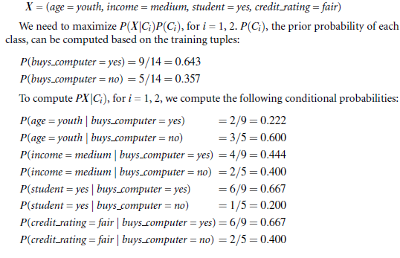

Slide 49
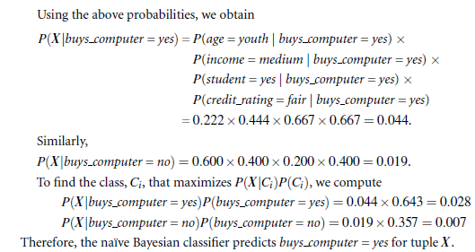

Slide 50
Bayesian Belief Networks
Bayesian belief networks specify joint conditional probability distributions. They allow class conditional independencies to be defined between subsets of variables. They provide a graphical model of causal relationships, on which learning can be performed. Trained Bayesian belief networks can be used for classification. Bayesian belief networks are also known as belief networks,

Slide 51
Bayesian Belief Networks….
A belief network is defined by two components—a directed acyclic graph and a set of conditional probability tables.
Each node in the directed acyclic graph represents a random variable. The variables may be discrete or continuous-valued. They may correspond to actual attributes given in the data or to “hidden variables” believed to form a relationship (e.g., in the case of medical data, a hidden variable may indicate a syndrome, representing a number of symptoms that, together, characterize a specific disease).
Each arc represents a probabilistic dependence. If an arc is drawn from a node Y to a node Z, thenY is a parent orimmediate predecessor of Z, and Z is a descendant of Y. Each variable is conditionally independent of its nondescendants in the graph, given its parents.yesian networks, and probabilistic networks

Slide 52
